Slide 1
GREENER FUTURE
Satakunta

Slide 2
1
6
Wind Power
By-Products to Use in Peittoo
Kirkkokallio Industrial Park
Contributing to a Sustainable Future
A Cooperation That Matters
LNG Terminal in Pori
Towards a Lower Environmental Impact with LNG
60 M€ Investment in Our Future
Waste-to-Energy in Harjavalta
Finland’s First Battery Cluster
Low-Emission Vanadium
Biogas from Harjavalta
Sustainable Bioconversion
2
7
8
3
9
4
10
5

Slide 3
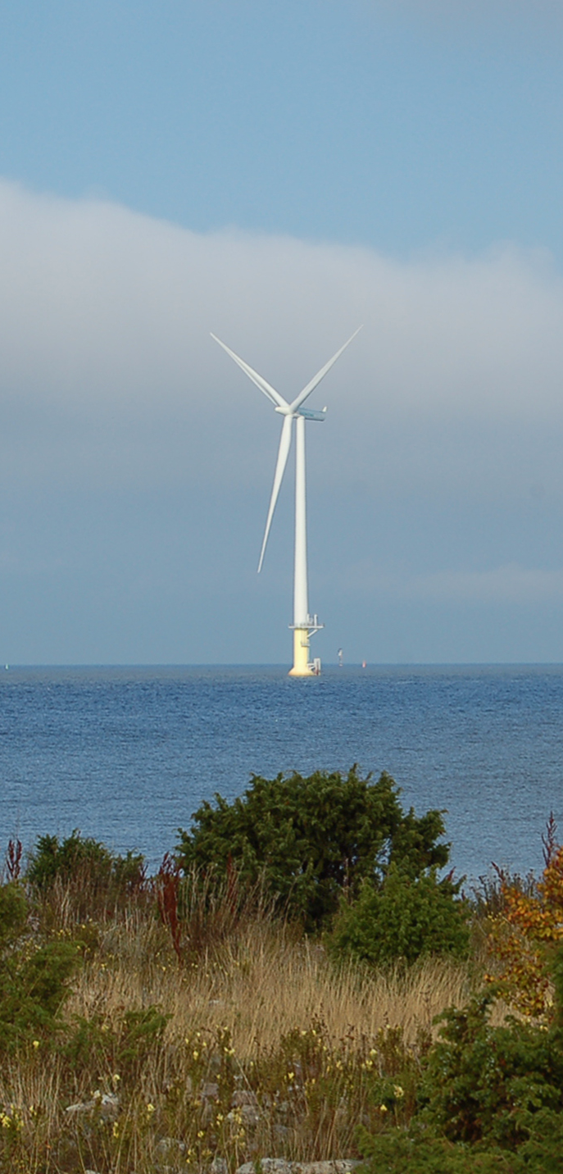
Wind Power
Suomen Hyötytuuli Oy
11,0%
In terms of wind power, Satakunta is Finland's third largest producer.
1. NORTH OSTROBOTHNIA
2. LAPLAND
3. SATAKUNTA
Satakunta's share of wind power production in Finland
2018
Notes:
https://energia.fi/uutishuone/materiaalipankki/sahkontuotanto_maakunnittain_2007-2018.html#material-view

Slide 4
By-Products to Use in Peittoo
In Peittoo in Pori, there is a recycling park promoting the utilization of by-products in Satakunta.
In addition to a wind farm, several companies operate in the area. Examples include Stena Recycling and Fortum.
Close to Highway 8 and the Port of Pori
Processing, storage and disposal of industrial by-products
760 hectares
Notes:
https://www.prizz.fi/kehittamisteemat/bio-ja-kiertotalous/peittoon-kierratyspuisto-peittoo-recycling-park.html

Slide 5
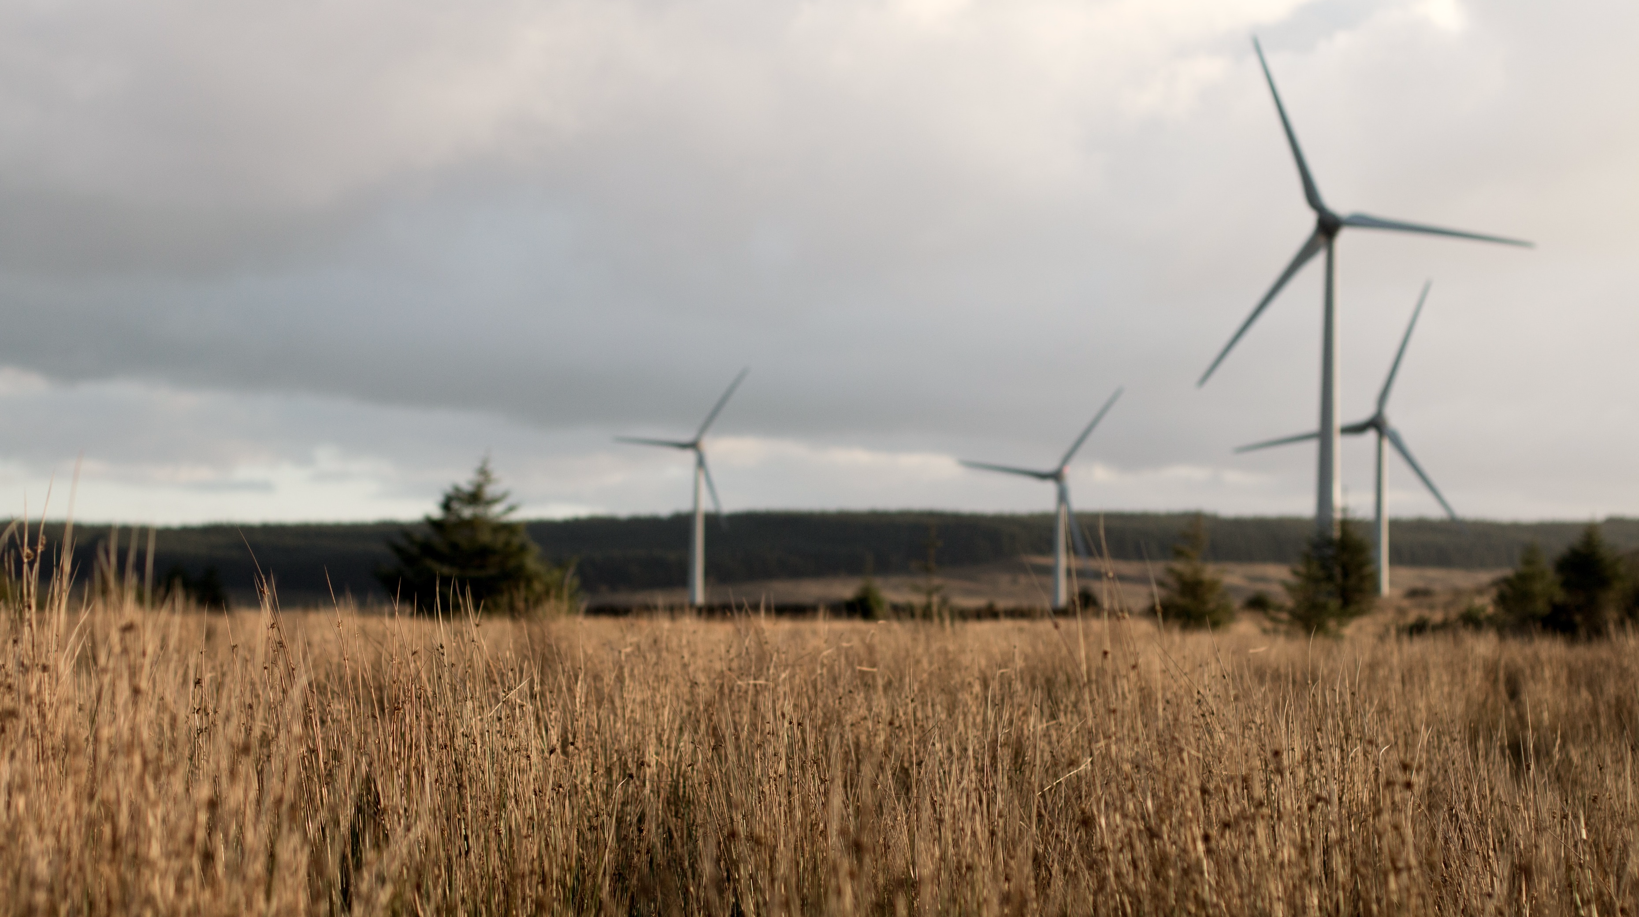
Kirkkokallio Industrial Park
The companies in Kirkkokallio, Honkajoki co-produce bioenergy and operate according to the principles of circular economy.
Finnish Climate Action Award 2017
Notes:
https://www.kankaanpaanseutu.fi/a/200149458
https://www.vatajankoski.fi/kirkkokallion-energiapuisto-kiertotalouden-edellakavija/
https://www.honkajokioy.fi/al-energia-kiertaa-kuin-ikiliikkuja/

Slide 6
Contributing to a Sustainable Future
Gasum’s biogas plant
Vatajankoski’s power plant
Honkajoki Wind Farm
KKK-vihannes (Ikaalisten luomu), Hevikolmio ja Honkatarhat greenhouses
Lihajaloste Korpela specializing in meat processing
Honkajoki specializing in animal by-product processing
HONKATARHAT OY / HEVIKOLMIO OY
HONKAJOEN TUULIPUISTO
Notes:
https://www.kankaanpaanseutu.fi/a/200149458
https://www.vatajankoski.fi/kirkkokallion-energiapuisto-kiertotalouden-edellakavija/
https://www.honkajokioy.fi/al-energia-kiertaa-kuin-ikiliikkuja/

Slide 7
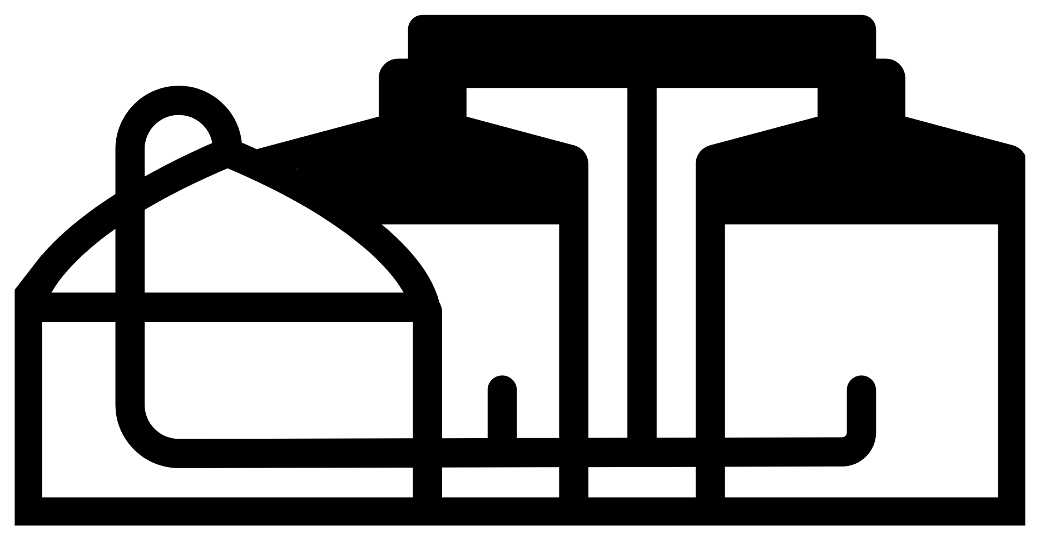
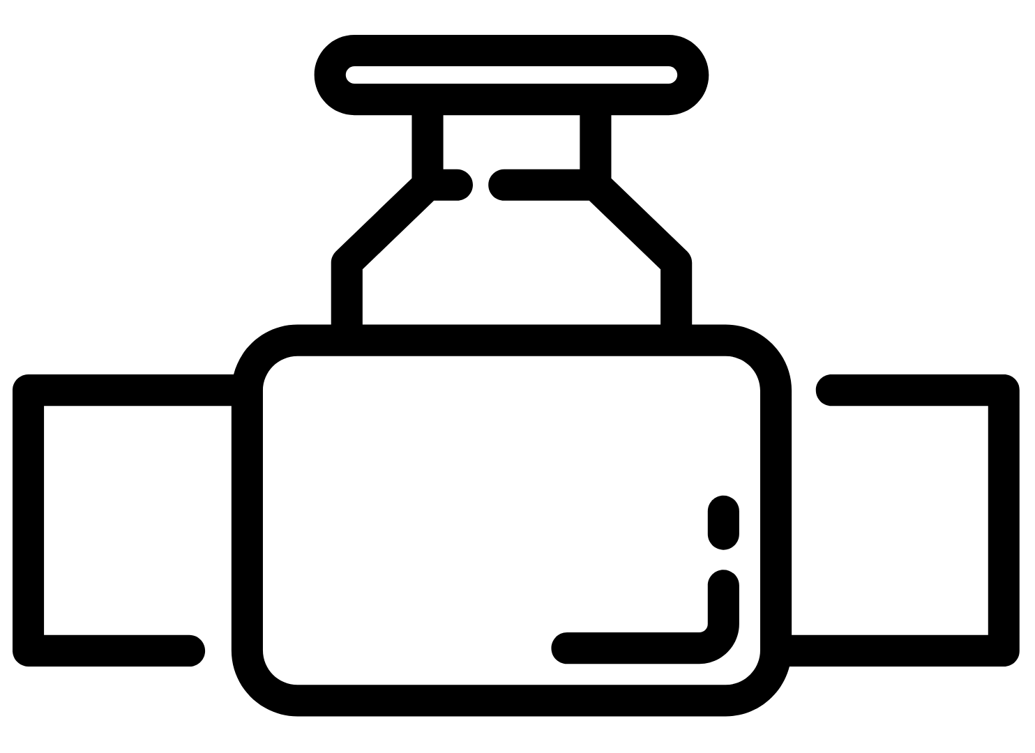
Gasum processes by-products and biowaste from the food industry in the area and outside of it at its biogas plant.
The biogas produced at the plant is delivered to the Vatajankoski power plant.
The companies also utilize the condensation heat generated in Honkajoki's processes.
The waste that cannot be used to produce biogas is utilized as an organic fertilizer on the fields.
The power plant generates electricity, heat and steam from the gas to meet the needs of companies in the area.
In addition, the wind farm generates electricity for the companies.
Notes:
https://www.kankaanpaanseutu.fi/a/200149458
https://www.vatajankoski.fi/kirkkokallion-energiapuisto-kiertotalouden-edellakavija/
https://www.honkajokioy.fi/al-energia-kiertaa-kuin-ikiliikkuja/

Slide 8
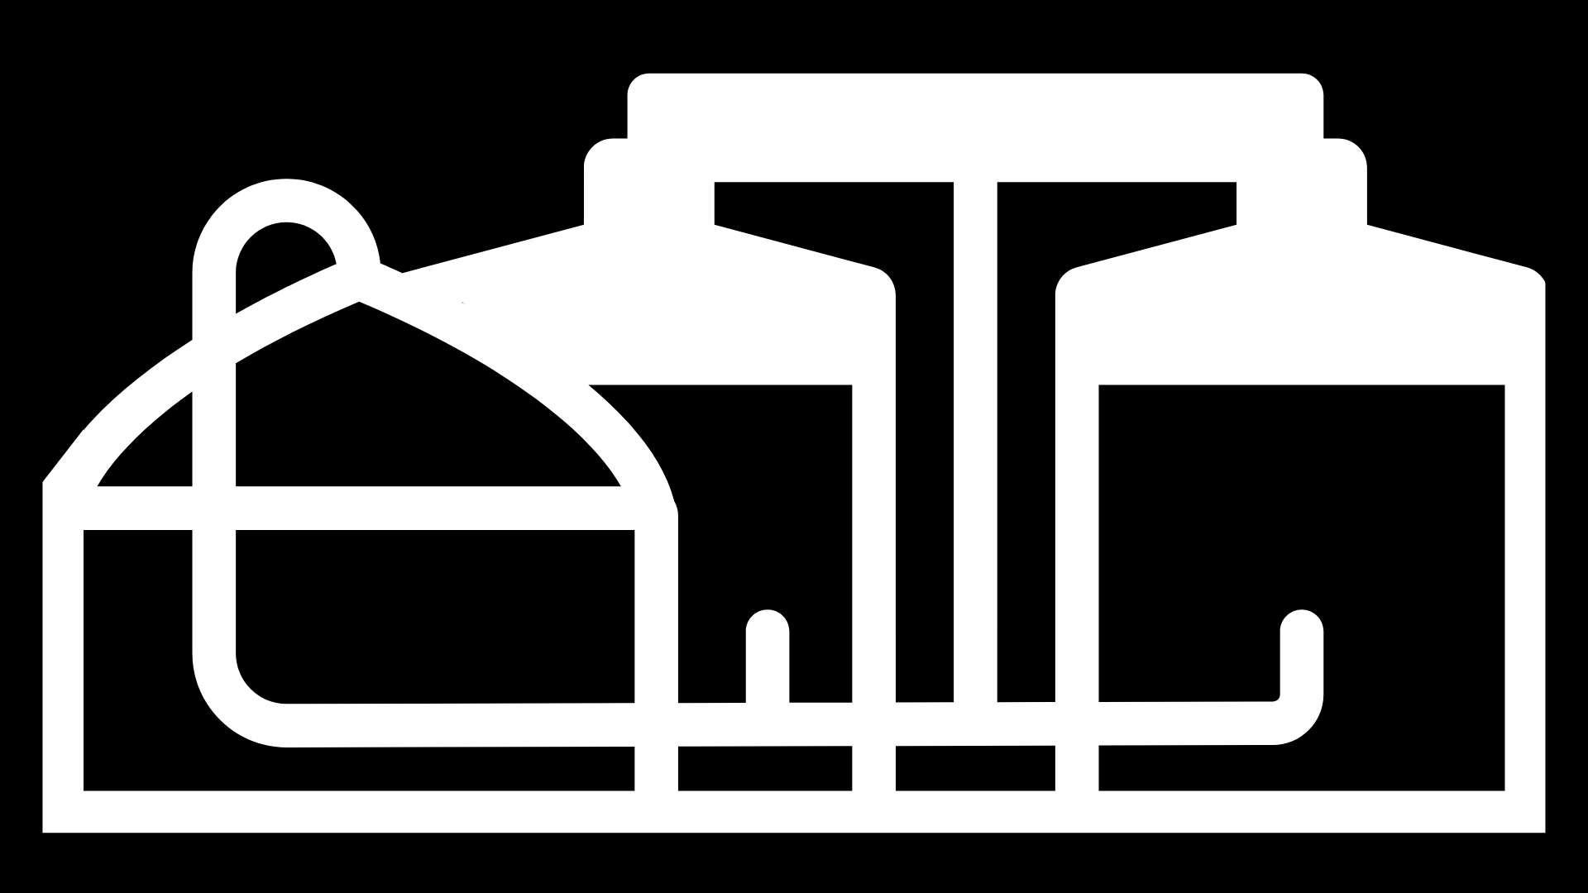
A Cooperation That Matters
€
€
100 M€
The total turnover of the companies in the area
100 M€
Investments in the past years
60 Mkg
The amount of waste processed at the biogas plant during a year
5 Mm³
The amount of biogas produced at the biogas plant during a year
Notes:
https://www.vatajankoski.fi/kirkkokallion-energiapuisto-kiertotalouden-edellakavija/
https://www.gasum.com/kaasusta/biokaasu/biokaasulaitokset/honkajoen-biokaasulaitos/

Slide 9
LNG terminal in Pori
No sulfur oxides and relatively little other emissions ➝ environmentally friendly
Finland’s first liquefied natural gas (LNG) terminal is located in Pori.
600 times smaller volume compared to non-liquefied gas ➝ flexible to transport and store
Gasum
Notes:
https://www.gasum.com/

Slide 10
Towards a Lower Environmental Impact with LNG
Nornickel Harjavalta is one of the major users of liquefied natural gas in Satakunta.
The carbon footprint of Nornickel’s hydrogen production has decreased by
20%
Giving up fuel oil has reduced Nornickel’s CO2 emissions by approx.
100 000 t
Nornickel Harjavalta
uses LNG for hydrogen and energy production
Notes:
https://yle.fi/uutiset/3-9160504
https://www.gasum.com/ajassa/energia--teollisuus/2020/nornickel-harjavalta-merkittavaa-liiketoimintaetua-lngsta/

Slide 11
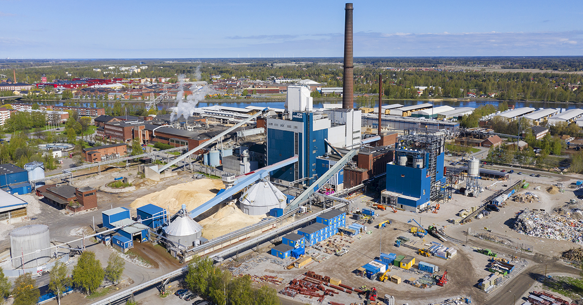
60 M€ Investment in Our Future
The Aittaluoto power plant in Pori produces district heat, process energy and electricity.
The investment completed in 2020 has modernized the power plant to meet environmental requirements and growing energy needs. As a result of the modernization, the use of fossil fuels will decrease and the use of biofuels will increase accordingly.
Pori Energia Oy / Tomi Glad
Less CO2 emissions by
THOUSANDS OF TONNES
Lower annual fuel demand by
600 TRUCK LOADS
Notes:
https://www.porienergia.fi/yritys/Hankkeet/Aittaluoto-2020--hanke#.X5vMLYgzZPY

Slide 12
Waste-to-Energy in Harjavalta
Suomen Teollisuuden Energiapalvelut STEP Oy intends to build a waste-to-energy plant in Suurteollisuuspuisto Industrial Park in Harjavalta. The plant will produce steam for the energy needs of the companies in the area. The plant will use SRF, Solid Recovered Fuel, which offers a means of recovering a significant proportion of industrial waste. SRF has previously been transported long distances from Satakunta, and, thus, the new plant will reduce logistics emissions and increase cost efficiency.
2023-2024
plant up and running
40 M€
investment
Notes:
https://www.satakunnankansa.fi/a/5c98d318-32d2-4d1d-a4e3-f97c44f41efe
https://www.nornickel.fi/b/uusi-kiertotalousvoimalaitos-harjavaltaan

Slide 13
Finland’s First Battery Cluster
Nornickel
A unique battery recycling cluster is emerging in Suurteollisuuspuisto Industrial Park in Harjavalta as a result of the cooperation of three companies.
BASF's battery material plant will start operations in 2022. The plant will utilize the nickel and cobalt produced by Nornickel Harjavalta and the recycled materials processed at the battery recycling plant acquired by Fortum.
80% of valuable battery materials are recovered at Fortum’s battery recycling plant, which is unique on a global scale
Notes:
https://lansireitti.fi/battery-cluster/
https://www.aamulehti.fi/a/eabb529e-4511-4f5d-9d22-bb64eb210a87
https://www.nornickel.fi/
https://www.gasum.com/ajassa/energia--teollisuus/2020/nornickel-harjavalta-merkittavaa-liiketoimintaetua-lngsta/

Slide 14
Low-Emission Vanadium
1
Critical Metals and Neometals, two Australian companies, have chosen the Port of Pori as the location for their sustainable vanadium recovery and production plant. The location was selected thanks to its excellent logistics and ice-free harbor. The aim is to use by-products from steel production to recover vanadium for use in e.g. steels and energy storage solutions. The process utilises renewable energy and a significant amount of CO2 gas sequestered from local industrial sources. The production is planned to begin late 2024. This investment is very important for Europe given Europe’s goals with respect to raw material resilience and circular economies.
EUROPE’S FIRST sustainable vanadium recovery plant
Notes:
https://portofpori.fi/critical-metals-to-build-sustainable-european-vanadium-production-facility-in-finland/

Slide 15
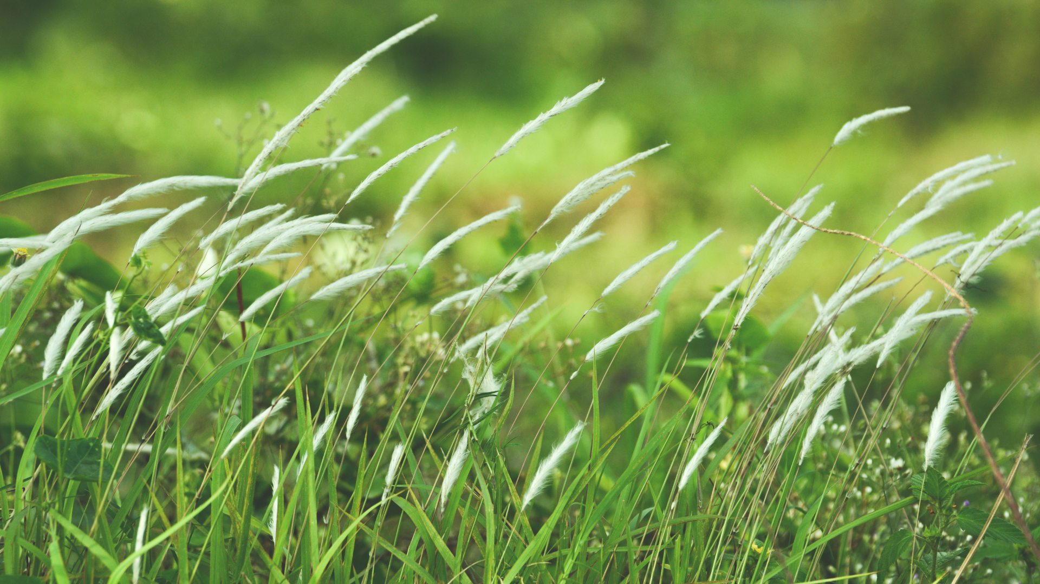
Biogas from Harjavalta
SATbioGAS aims to develop the production and availability of biogas in Harjavalta.
The planned plant, projected to be completed in 2021, would utilize failed crops and wasted cultivation areas for the production of biogas, wood pellets and organic fertilizer.
15 000 -
20 000 t
biomass processed annually
Notes:
https://satbiogas.com/

Slide 16
Sustainable Bioconversion
BioEnergo is planning a bioconversion plant in the Kaanaa industrial area in Pori. The aim is to produce bioethanol, biogas and lignin from the by-products of the forest industry and sawmills. The final investment decision will be made in 2020 or 2021. The plant would be a 150-170 M€ investment.
32 000 TONNES of petrol can be replaced by the bioethanol produced at the plant.
Thus, there will be
100 000 TONNES
less traffic emissions annually.
Notes:
http://bioenergo.fi/
https://www.satakunnankansa.fi/a/3eb678f5-060a-4ee3-9f09-50ebe05dc08e

